Slide 1
FULLSTACK PROJECT-2 (VISION)
Mentored by: Mandeep Singh

Slide 2

Team Members:
Adarsh Kumar(181500037)
Ritik Srivastava(181500578)
Shalini Kumari(181500649)
Shashank Agrawal(181500652)
Vanshika Agrawal(181500780)

Slide 3
Objective:
Vision is a platform where users can post about their happy memories. The post would act as a snapshot of a particular memory which can be revisited by using our platform. Human brain has a special part dedicated to memories.
Our brain tends to remember the things that impact our brain too much and brought big change in our life. But there are other memories also which are not that impactful but which have played significant role in shaping our life. It is important to recollect these memories at certain point of our life to gain the motivation and inspiration of moving ahead.

Slide 4
Pages Of Vision (MERN Stack)

Slide 5
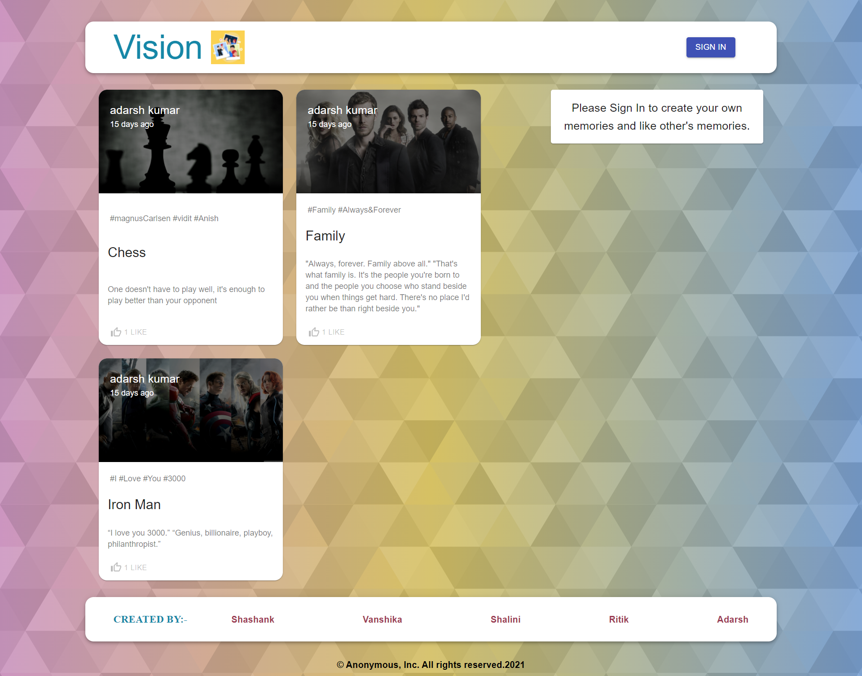
Home Page:

Slide 6
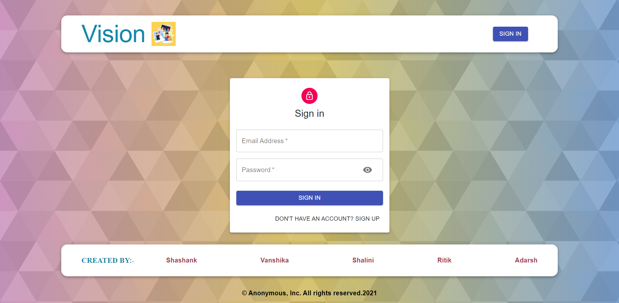
Authentication Page:

Slide 7
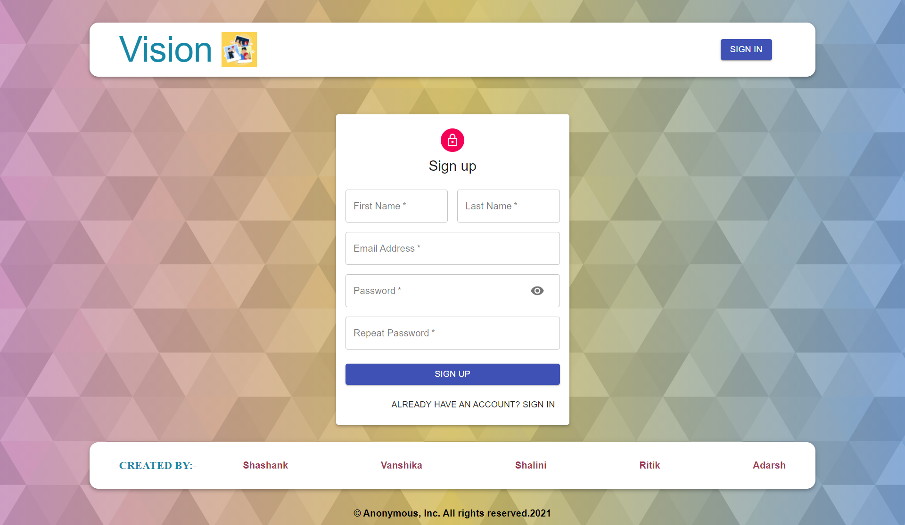

Slide 8
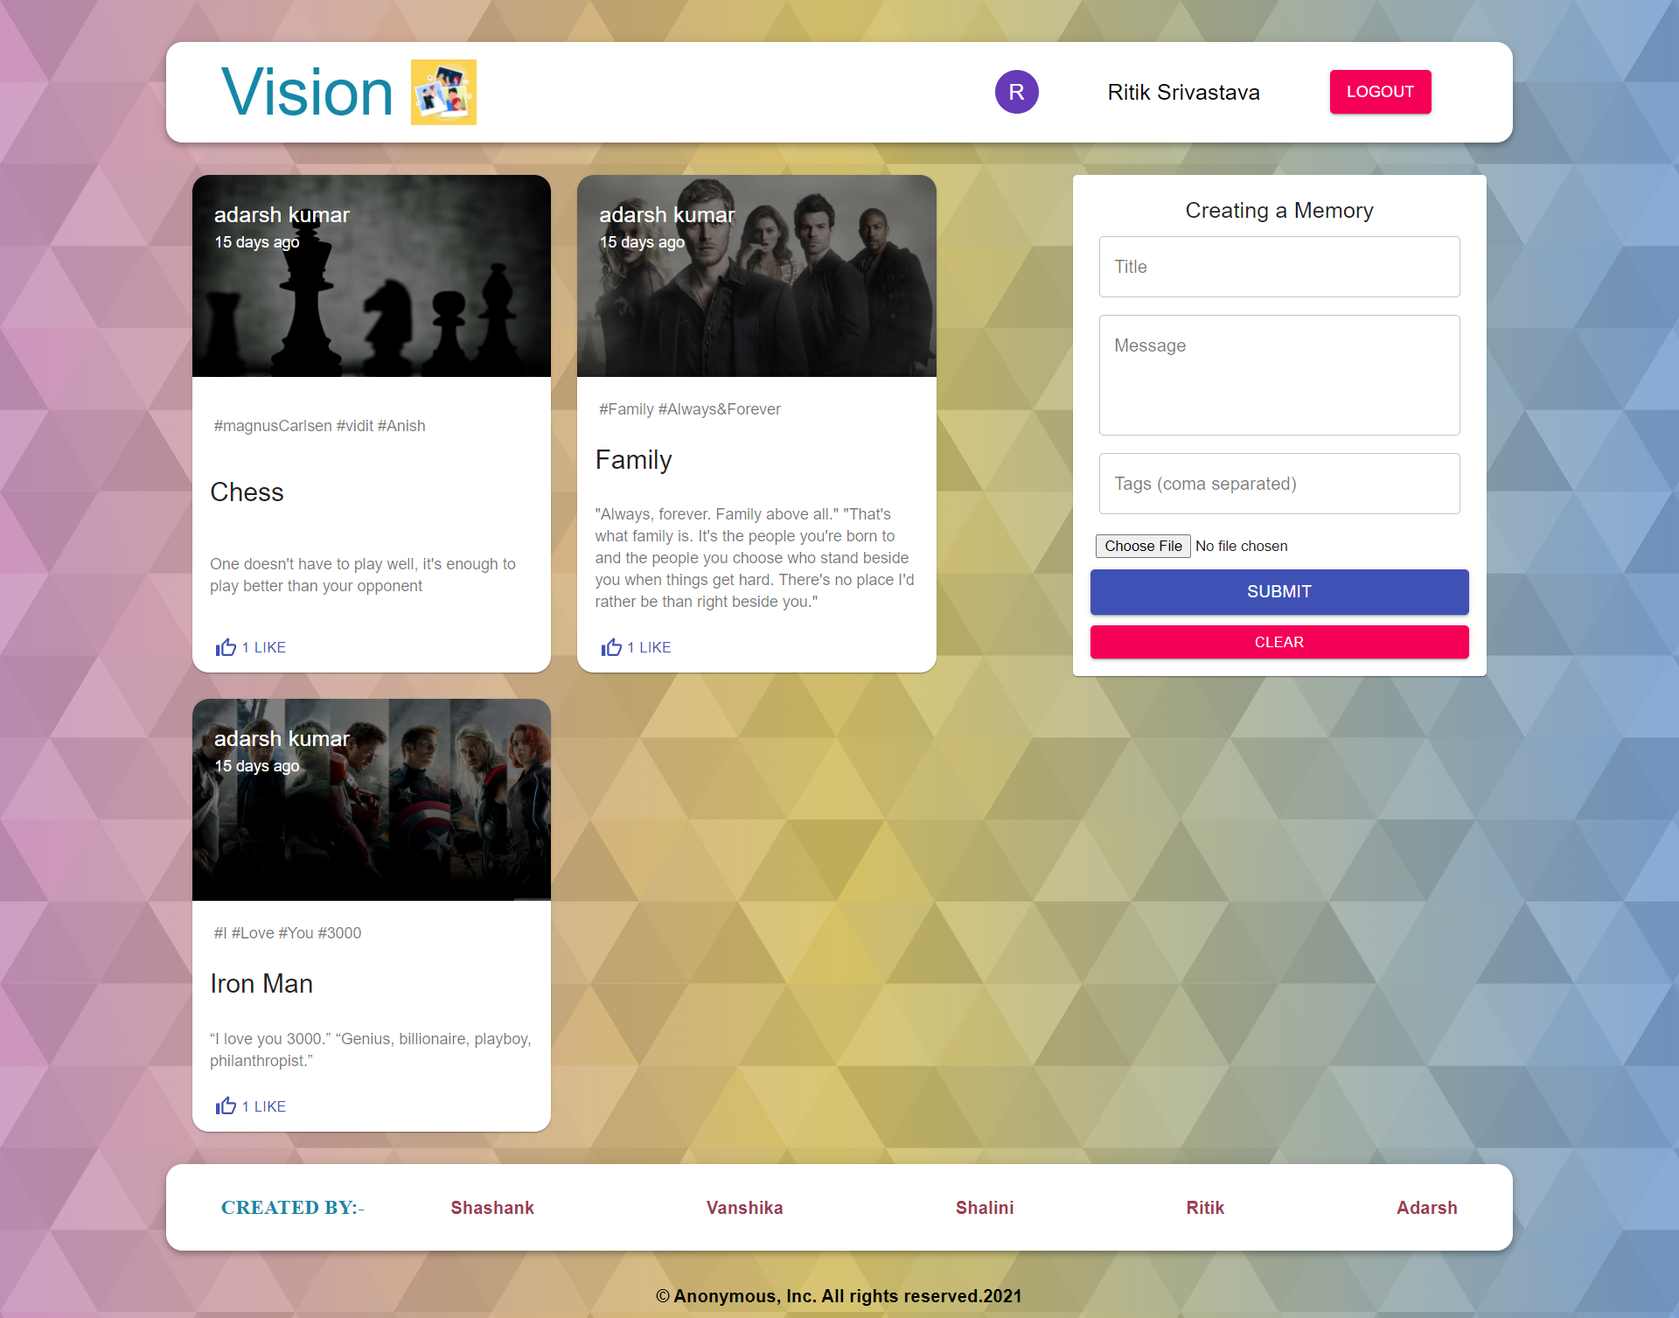
Loged-In Page:

Slide 9
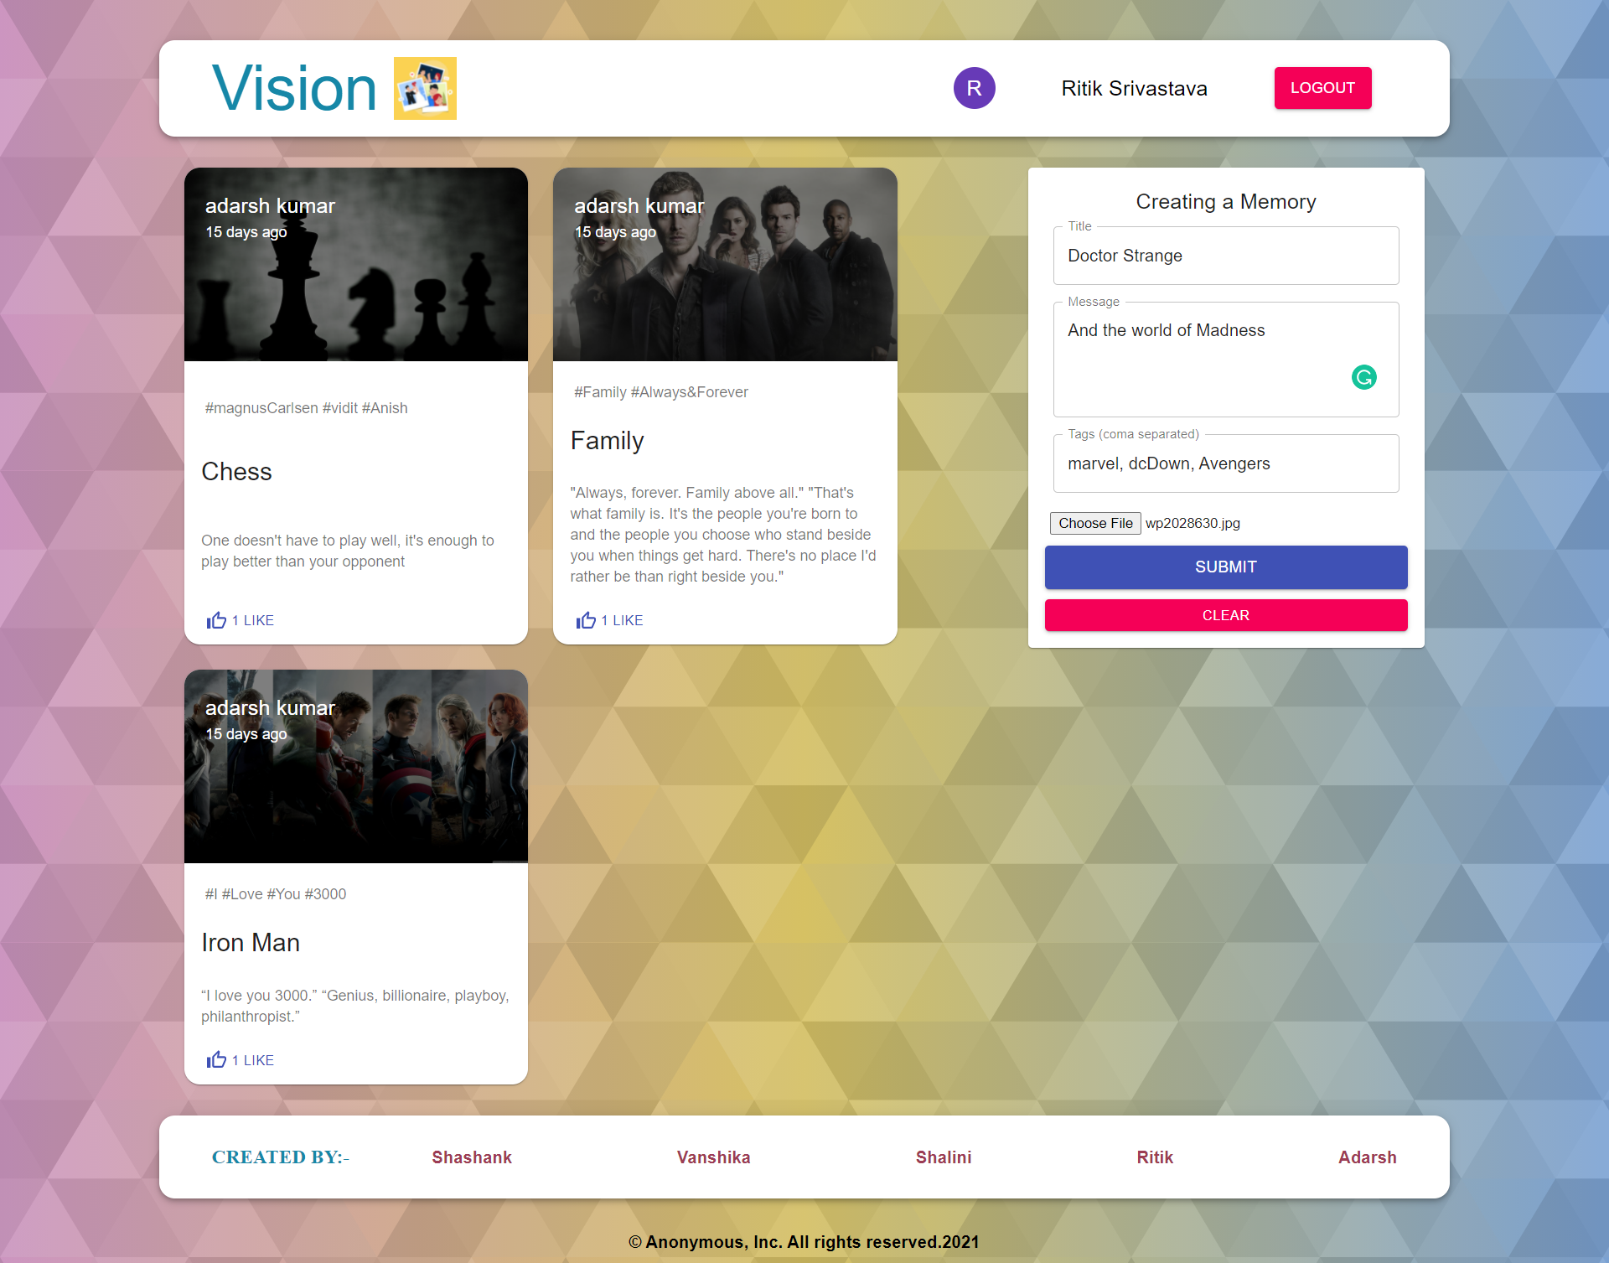
Other Pages:

Slide 10
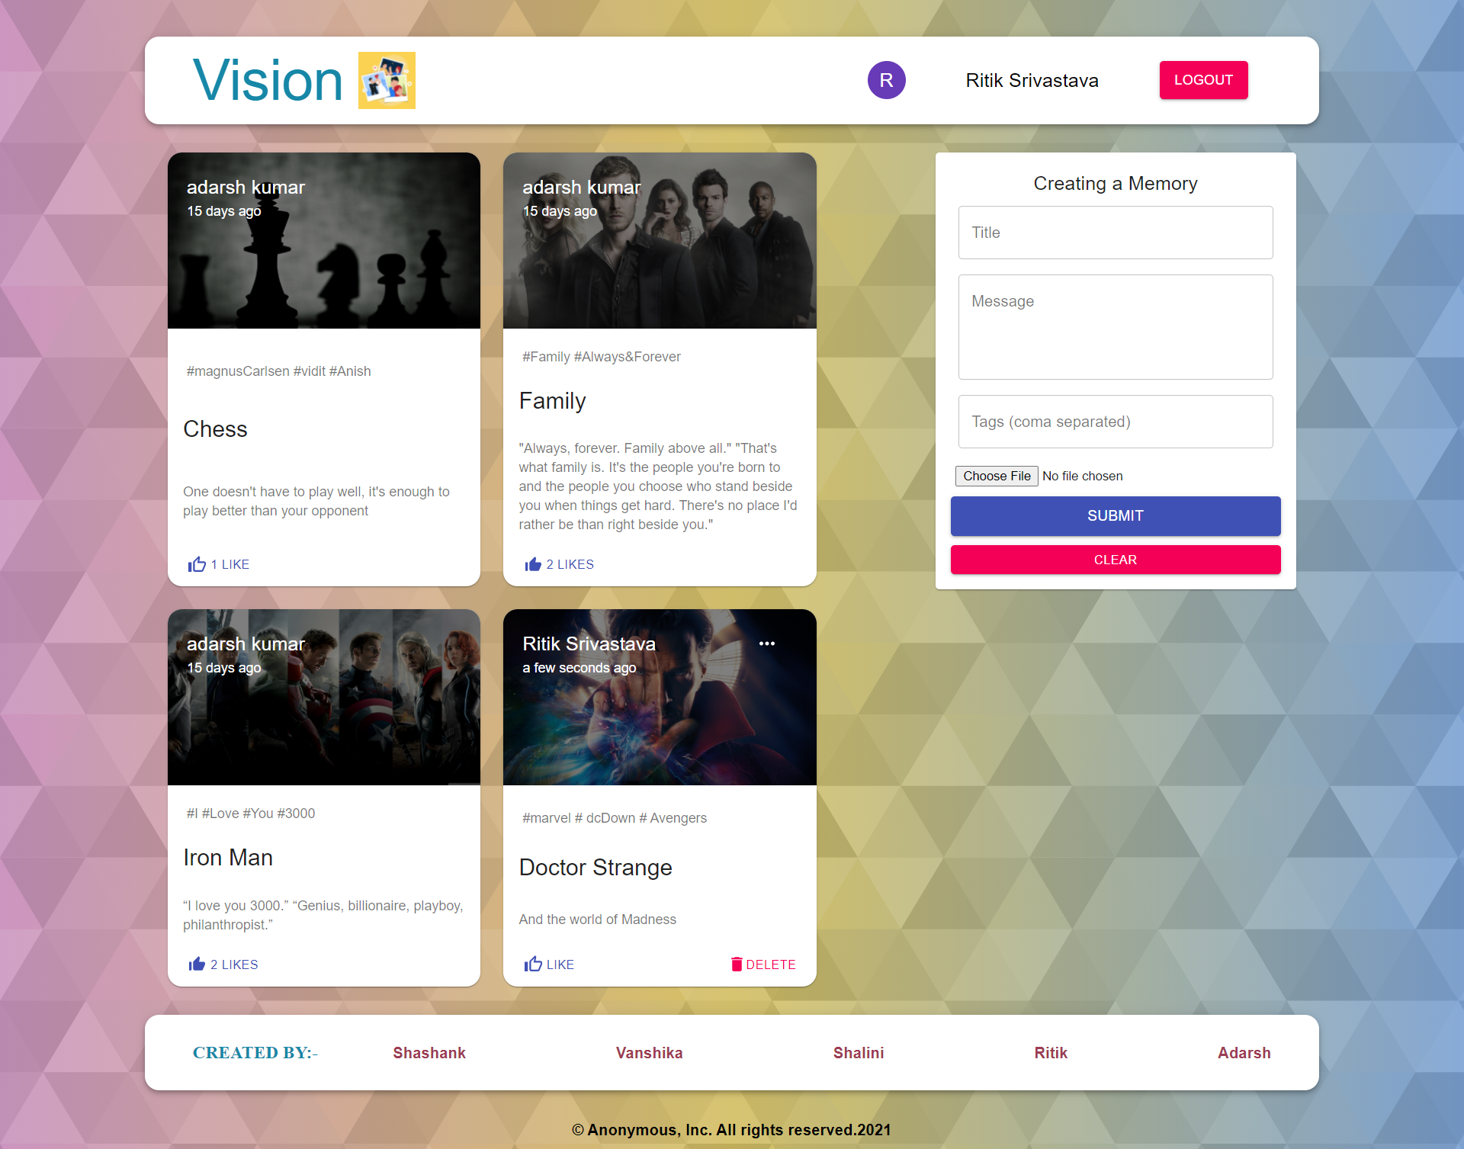

Slide 11
Database & Deployment Of Vision

Slide 12
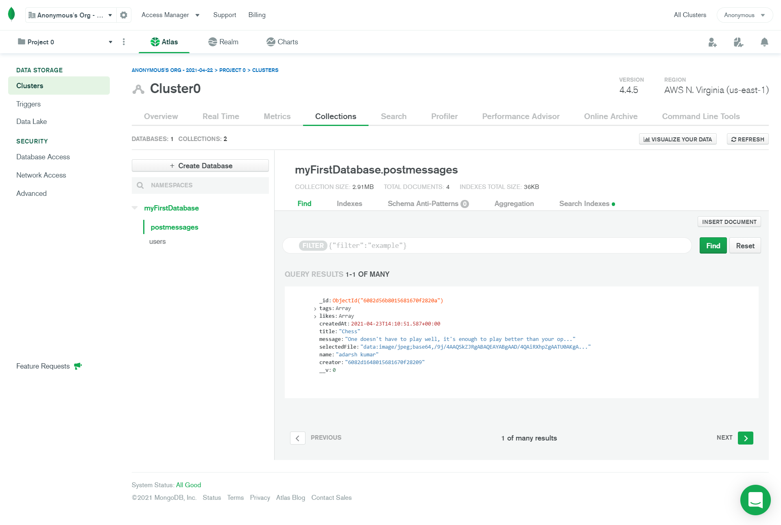
MongoDB Atlas Collection:

Slide 13
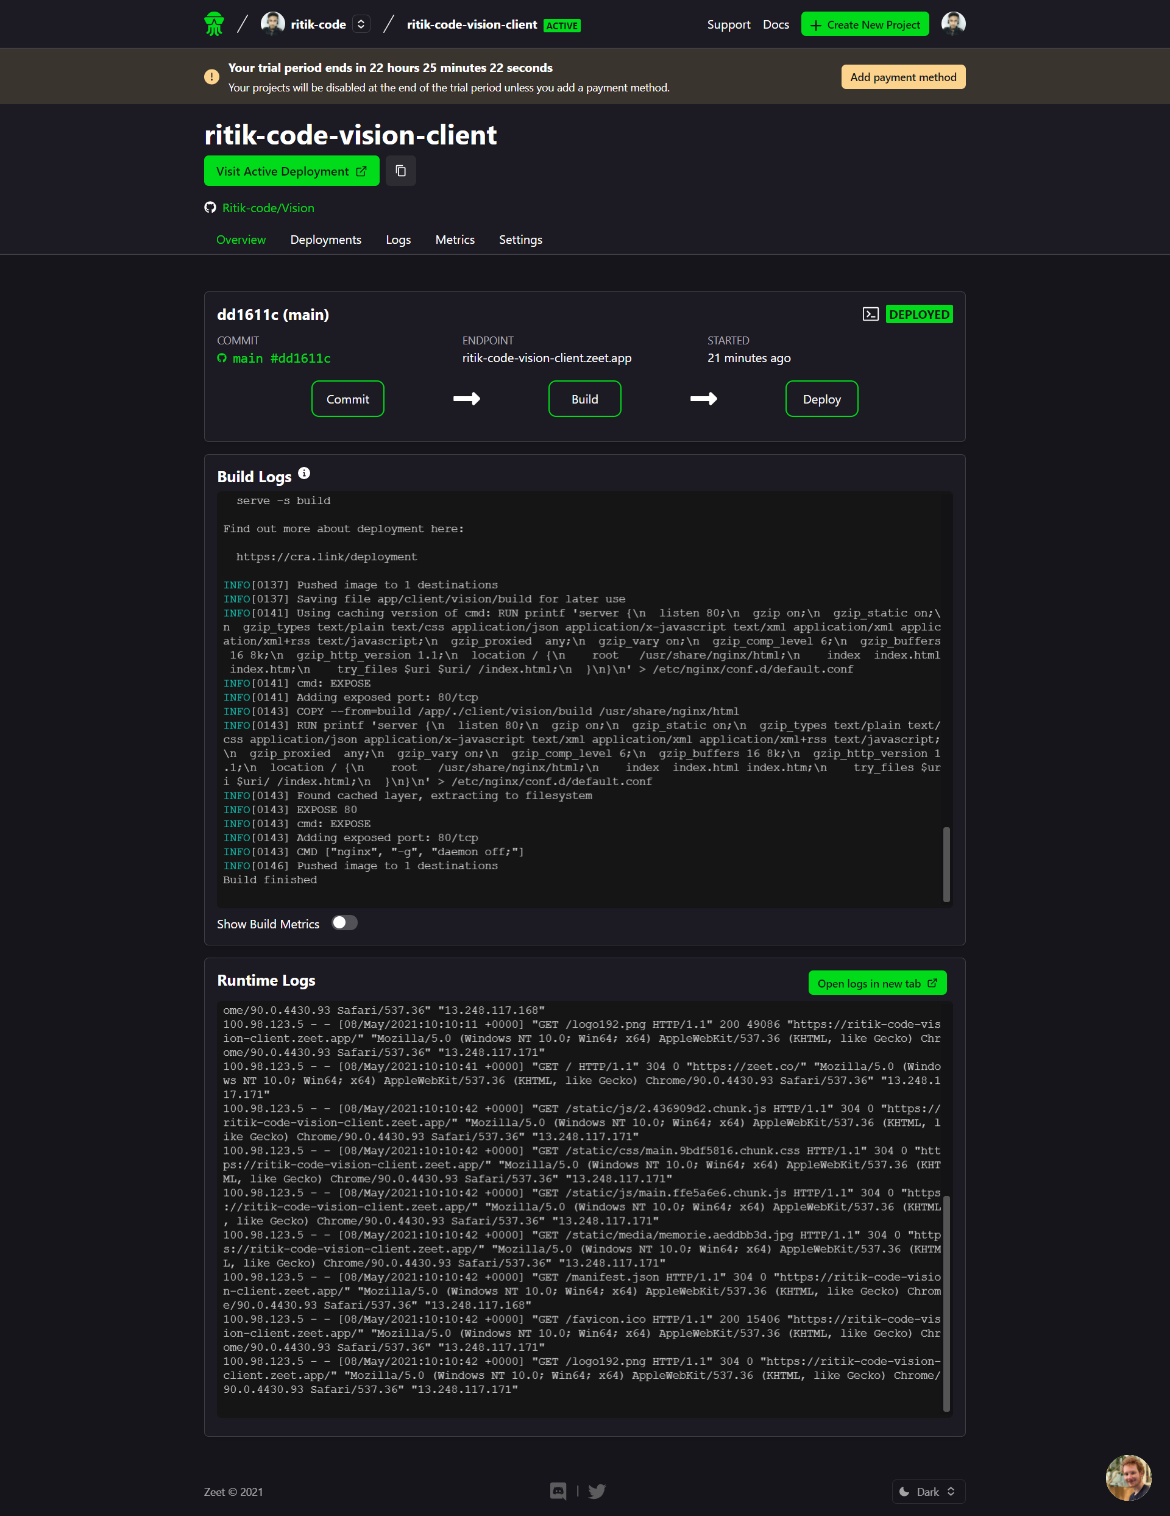
Zeet Deployment:

Slide 14
THANK YOU

